Slide 1
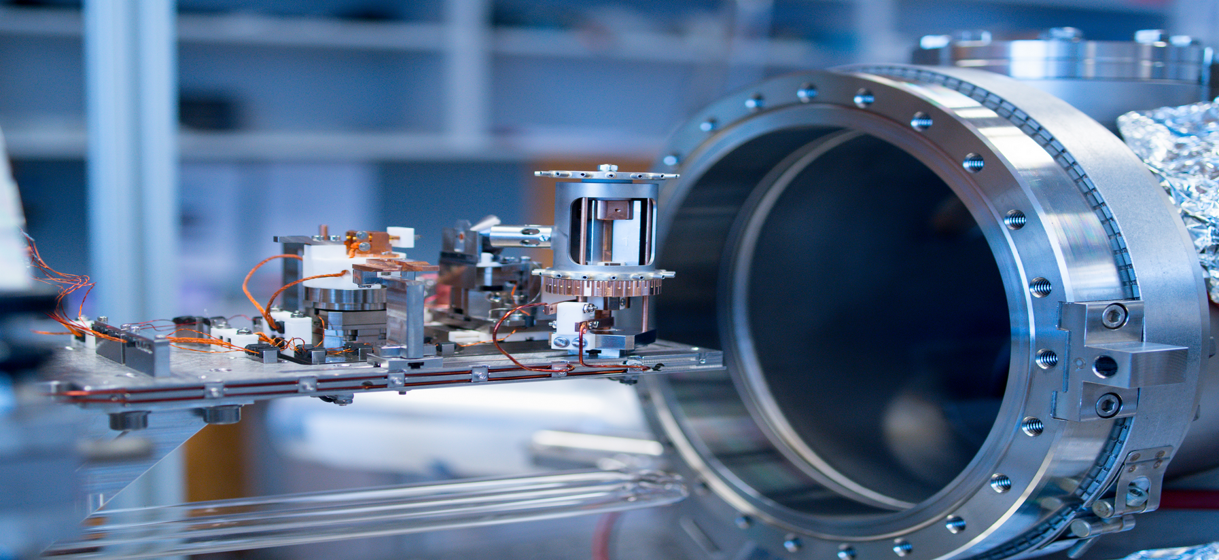
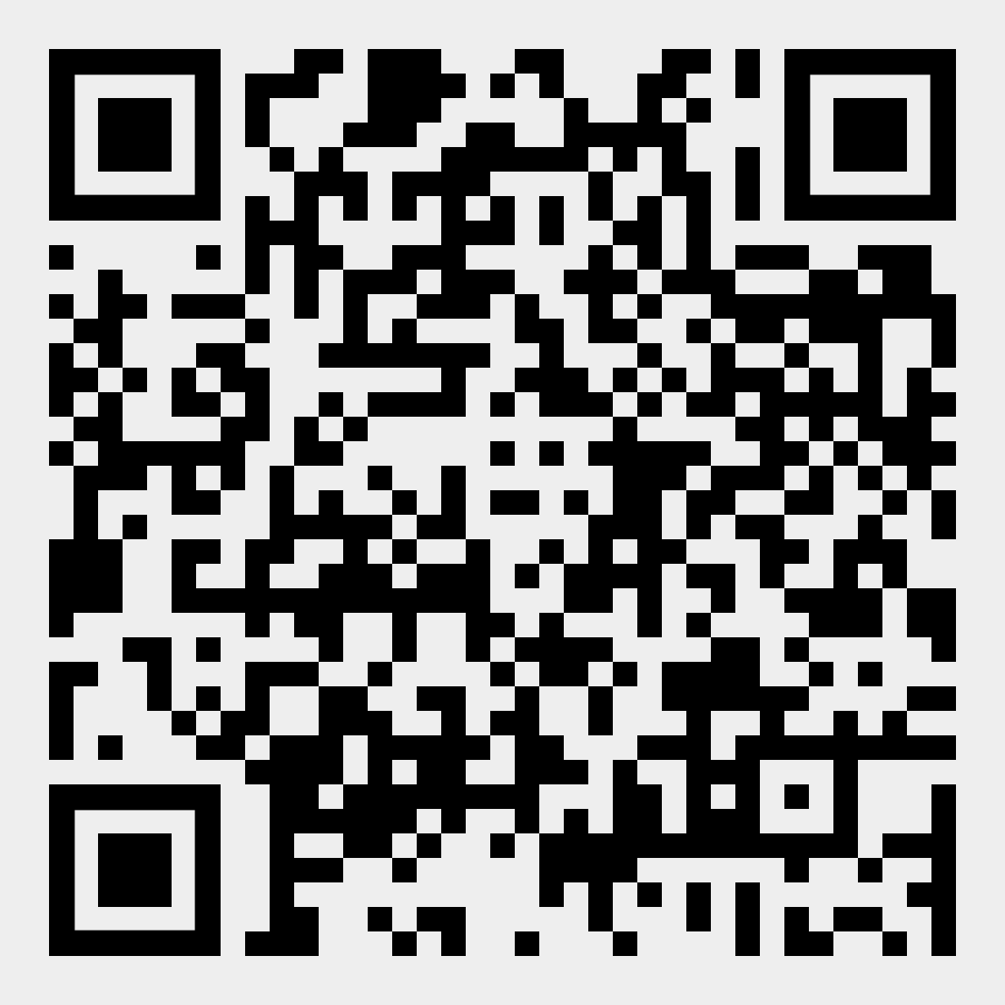
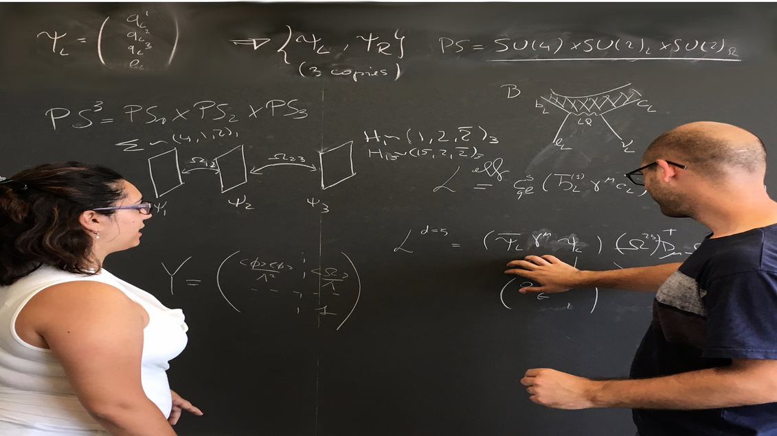
Physik-Institut
Admission
Bachelor’s degree in physics (180 ECTS credits)
from recognized university
Registration windows:
Fall semester: 1 January – 30 April (recommended)
Spring semester: 1 July- 30 November
Fees
Tuition Fee per Semester: 820.-
Contact
studium@physik.uzh.ch
www.physik.uzh.ch
Physics Master’s Program
at the University of Zurich
Flexibility: combination of core and elective courses, experimental and theoretical focus, two options for the duration of the Master’s thesis.
Choice: specialization in a particular area or maintain a broad focus across the discipline.
Master’s thesis: 30 or 50 ECTS credits within one of the research groups.
Research Areas: Astro(particle) & Cosmology, Bio & and Medical Physics, Condensed matter and Particle Physics.
Length: 3 semesters (90 ECTS credits), option of an additional minor (30 ECTS).
Network: with external institutes, eg Paul Scherrer Institute (PSI), DESY or CERN.

